Slide 1
ROBOTIC INDOOR LOCALIZATION
USING INERTIAL MEASUREMENT UNITS

Slide 2
Robotic Indoor Localization using IMUs
Group No: 50 Date: 14/08/2015
Team Members
Project Advisor (Guide) : Dr. Vidhya Balasubramanian
S.No | Reg.No | Name | Section
1 | CB.EN.U4CSE12123 | Kiran Kassyap S | CSE-B
2 | CB.EN.U4CSE12133 | Ragul B | CSE-B
3 | CB.EN.U4CSE12147 | Sundarrajan G | CSE-B
4 | CB.EN.U4CSE12148 | Suriya D Murthy | CSE-B

Slide 3
Problem Statement
To develop an error reducing algorithm for Indoor localization of mobile robots using
the inertial measurement units(IMUs).

Slide 4
Motivation
Localization gives the answer to the question “Where am I ?”
Indoor localization is essential for proper navigation in building, obstacle avoidance, mapping of a building, also used in times of disaster and other emergency situations.
Current localization techniques are highly prone to error and its not completely reliable due to their lack of accuracy.
Thus writing an error reducing indoor localization algorithm helps to solve many real life problems.

Slide 5
Major Areas
Localization Algorithms
Mapping
Obstacle Avoidance

Slide 6
Hardware Specifications
Bstem Board.
Adcord Board.
IMU’S – Accelerometer, Gyroscope and Magnetometer.
Stepper motors and motor encoders.
Zippy 5000mah Li-Polymer battery
Robot Chassis
Wheels

Slide 7
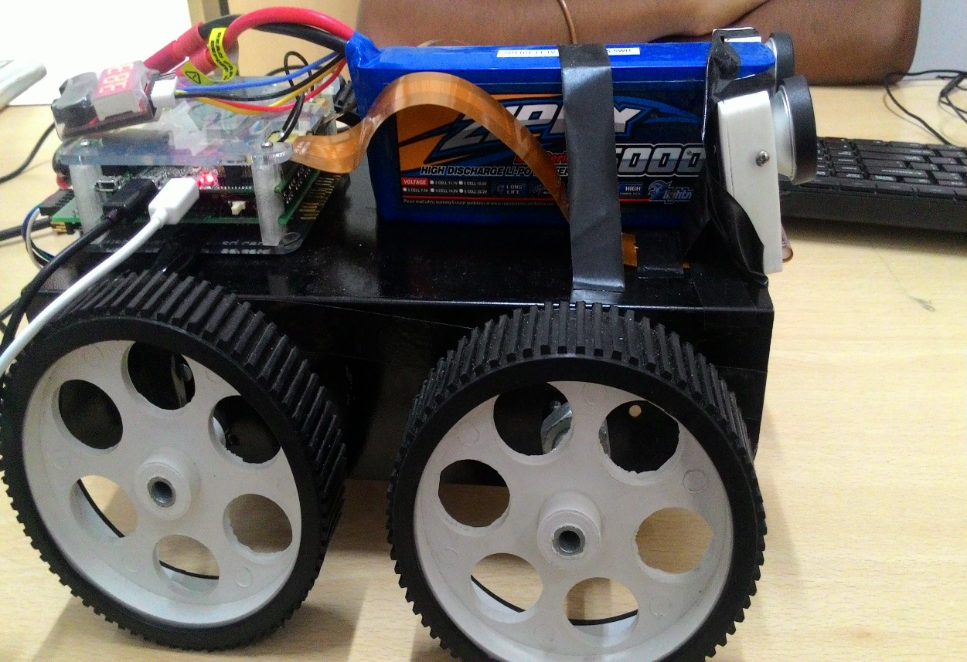

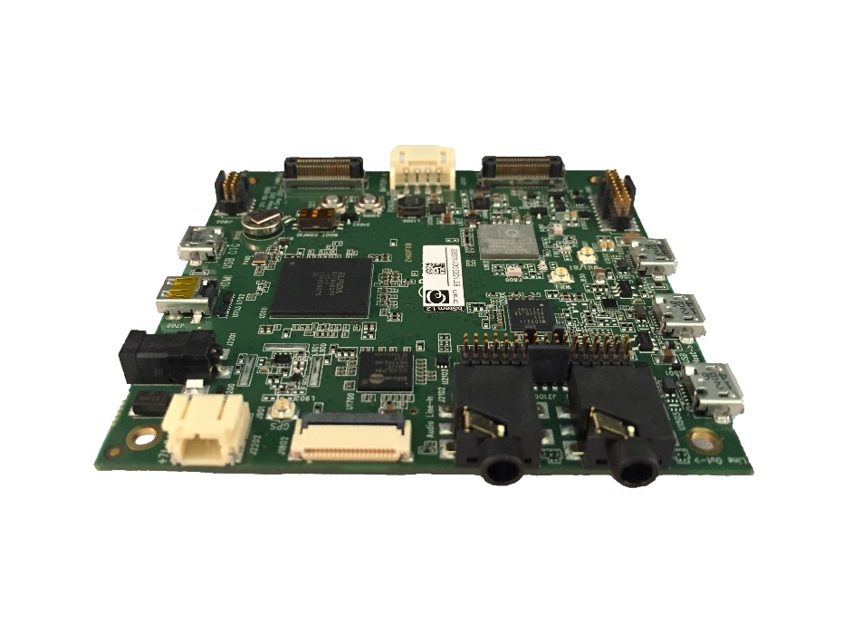
Robot

Slide 8
Software Specifications
Operating System - Ubuntu
Environment - Python
Library - Pygame
SSH is used to establish connection with the robot through Wi-Fi.
GIMP is used for rescaling the map of the building.

Slide 9
Base Paper
Ibrahim Zunaidi, Norihiko Kato, Yoshihiko Nomura and Hirokazu Matsui,
“Positioning System for 4-Wheel Mobile Robot: Encoder, Gyro and Accelerometer Data Fusion with Error Model Method”, Mie University, Japan.
This paper models the errors produced in sensors like accelerometer, gyroscope and encoders and uses the Kalman Filter to reduces these errors in position and orientation using a sensor fusion technique.
The Kalman filter is applied for position estimate using encoder and double integration of accelerometer.
The Kalman filter for orientation angle estimate using gyroscope and encoders.
We are working on implementing this base paper for error estimates in current localization techniques.

Slide 10
Architecture Diagram
Wi-Fi
IMUs
Gyroscope
Magnetometer
Accelerometer
Map Of The
Building
BSTEM
AdCord
Board
Ultra-Sonic Sensors
Motors and Motor Encoders

Slide 11
Internal Architecture Diagram
Accelerometer
Gyroscope
Motor Encoders
Xa,Ya
Wg
Xe,Ye
arctan
((Xl - Xr)/W)
((Yl - Yr)/W)
ʃ
ʃ
Ɵa
Ɵg
Ɵg
Ɵe
Kalman Filter
Kalman Filter
Ɵag
Ɵge

Slide 12
Literature Survey
Name of the paper | Author and Year of Publication | Methodology | Remarks
Positioning System for 4-Wheel Mobile Robot Data Fusion with Error Model Method | Ibrahim Zunaidi, Norihiko Kato, Yoshihiko Nomura and Hirokazu Matsui. Artificial Life and Robotics October 2006 | IMU and encoders are filtered using Kalman Filter to reduce errors in position and orientation using a sensor fusion technique | This approach is based on sensor fusion and due to kalman filters high computational complexity is observed
Self-Contained Indoor Positioning on Off-The-Shelf Mobile Devices | Dominik Gusenbauer, Carsten Isert and Jens Krösche,(IPIN), 15-17 September 2010. | Indoor positioning is done using pedestrian dead-reckoning method, GNSS and activity based map matching algorithms to reduce errors | IMU filtering is based on smartphones.

Slide 13
Literature Survey
Name of the paper | Author and Year of Publication | Methodology | Remarks
An Indoor Dead-Reckoning Algorithm with Map Matching | Haitao Bao, Wai-Choong Wong September 2013 | Map matching involved step counting algorithm and error reduction using Gaussian filters is proposed. | Gaussian filters have high computational complexities
Light Weight Map Matching Technique For Localization Using Conditional Random Field | Dominik Gusenbauer, Carsten Isert and Jens Krösche October,2012 | Indoor localization is done using a dead reckoning approach, which makes use of Veterbi algorithm and conditional random field to determine the position of the person using the mobile device | Conditional random field applies filtering only after specific distance travelled and hence immediate results cannot be obtained.

Slide 14
Work Plan
Study of existing algorithms.
Make the robot autonomous.
To integrate sensors and encoder values to find the distance travelled and angle of orientation of the robot and to plot the values in the provided map.
To devise an algorithm that corrects errors with help of the provided map and to obtain an accurate position of the robot in the given map.

Slide 15
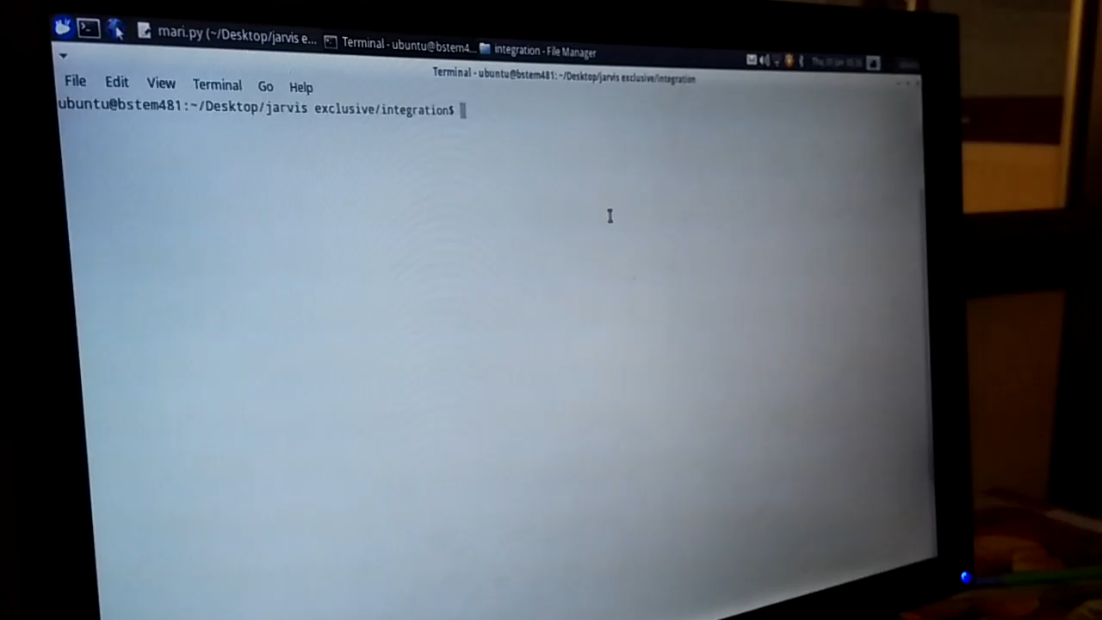
Implementation

